Slide 1
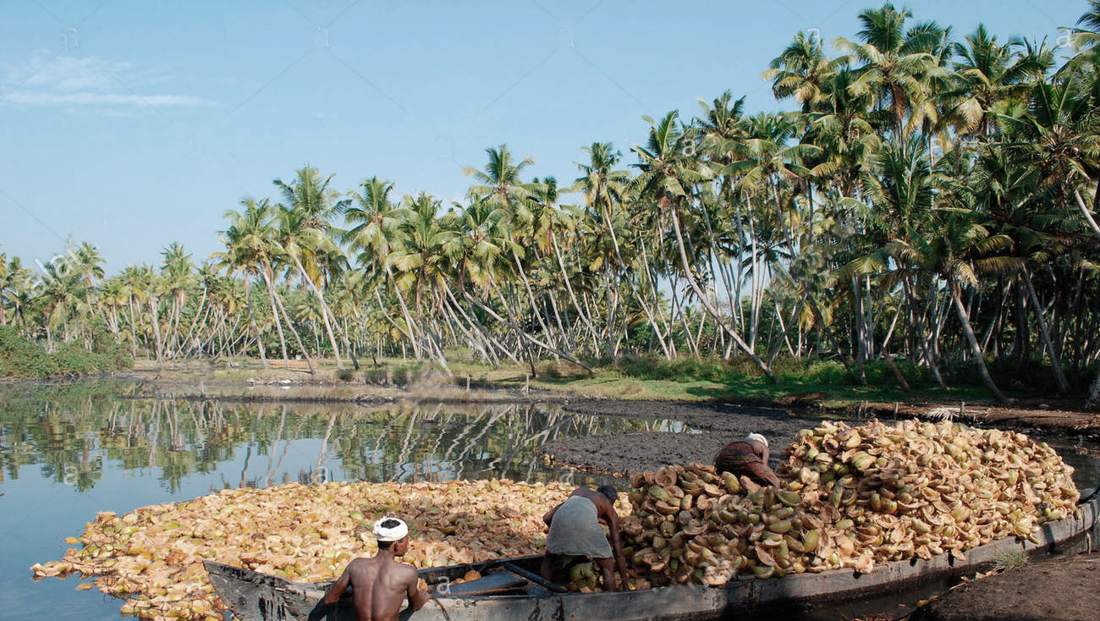

DIRECTORATE OF COIR DEVELOPMENT
WEBSITE DEVELOPMENT PROJECT
PRESENTED BY PRASHANT THOMAS HEAD – TECHNOLOGY & SOLUTIONS VERBAT TECHNOLOGIES

Slide 2






Project scope
Responsive design that scales well on desktops, tablets and mobile phones
To create a world-class website that will become the public face of the Directorate of coir development.
A responsive web that can be accessed across multiple devices.
An online resource for manufacturers, producers, distributers of coir products
A hub for disseminating news, events and activities coordinated by the coir department
An online portal to publicize information on coir products , manufacturers, exporters etc. as well as a portal for downloading forms , applications, tenders etc.
A public facing website that establishes the visual identity of the coir industry
Opportunity to improve marketing and increase brand value via meaningful engagement of social media

Slide 3







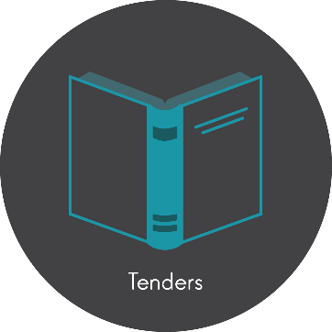
Website Main Features
Home Page English / Malayalam (Partial)
Project Offices & Coir Co-operatives
Products
Forms & Applications
Manufactures
Tenders & Important Orders
Exporters

Slide 4







Website General Features
News & Events
Image & Video Gallery
Marketing
Contact Details
Downloads
Allied Institutions
About us

Slide 5
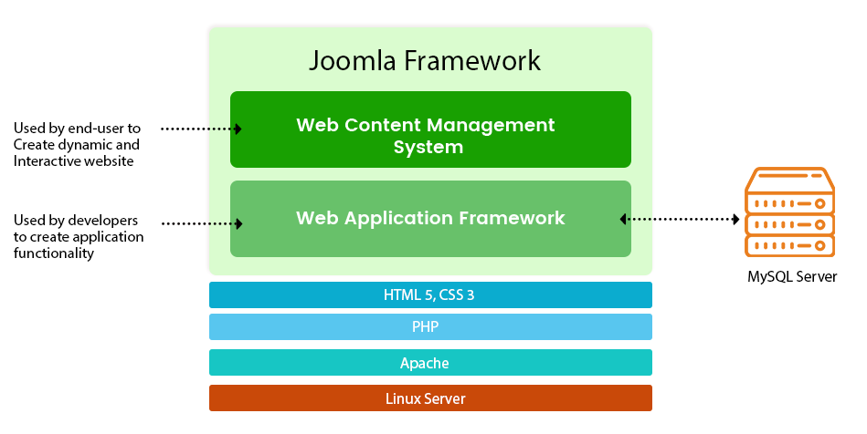
SYSTEM ARCHITECTURE

Slide 6
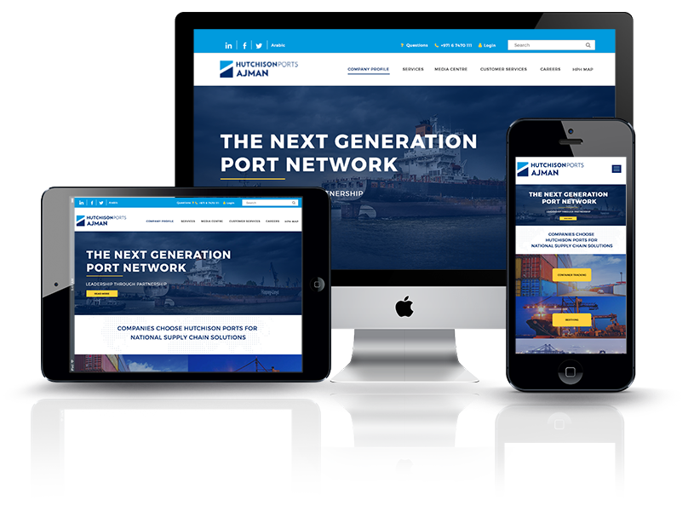
1
2
3
RESPONSIVE DESIGNS
MULTI BROWSER
PARTIAL MULTI LANGUAGE

Slide 7
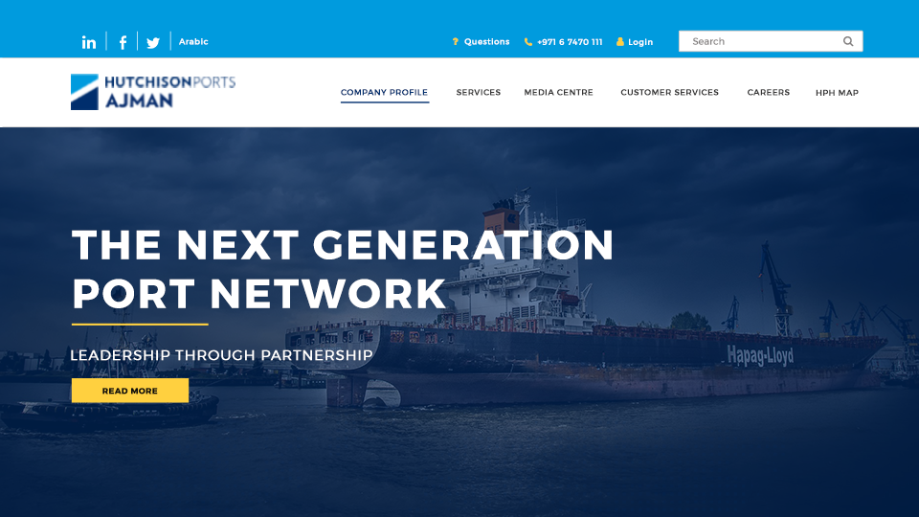

Slide 8

[
[
Q A
nd

Slide 9

Thank You
www.verbat.com
© 1999-2017. All Rights Reserved. Verbat Technologies (India) Pvt Ltd.

